Slide 1
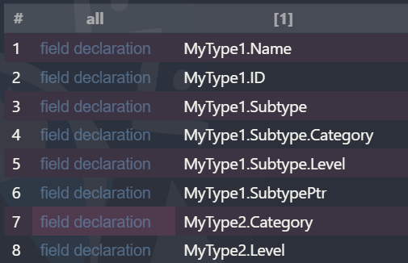
Step 1
Select all declared struct fields
Let’s call such set: F

Slide 2
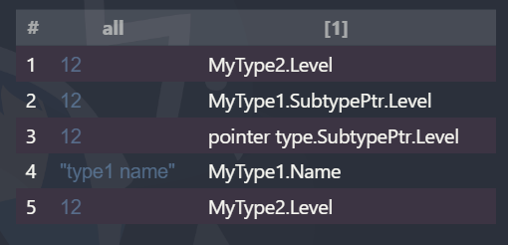
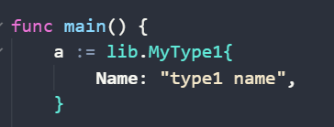
Step 2
Select all fields defined in the form of a struct literal (StructLit)
Let’s call such set: D
e.g. MyType1.Name has been accessed because it is explicitly defined in the program.

Slide 3
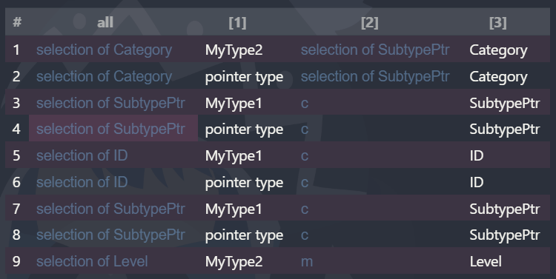
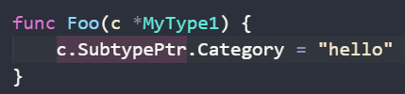
Step 3
Select all field been selected in program
Let’s call such set: S
e.g. MyType1.SubtypePtr.Category has been accessed because it’s part of a selector expression

Slide 4
Step 3
Select all field been selected in program
Let’s call such set: S
* Post-processing is needed because CodeQL selects both
c.SubtypePtr.Category and c.SubtypePtr,
whereas we only want c.SubtypePtr.Category to be considered.
This can be achieved by writing a simple script to prune intermediate steps in interpretedResults.sarif.
e.g. MyType1.SubtypePtr.Category has been accessed because it’s part of a selector expression

Slide 5

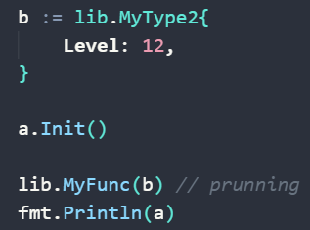
Step 4
Pruning all struct that flow into k8s call
Let’s call such set: P
e.g. Assume MyFunc() is a k8s call, we mark all field in MyType2 as been accessed.

Slide 6
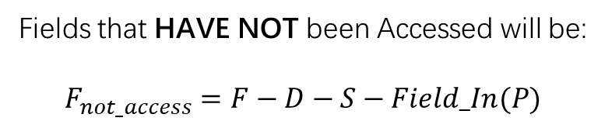
Step 5
Fields that HAVE NOT been Accessed will be:
$$F_{not_access}=F−D−S−Field_In(P)$$

